Slide 1



Reducing Disparities in Pediatric Asthma Outcomes:
Evidence-based pO₂licy Recommendations for Change
Presented by:
Floyd Malveaux, MD, PhD
Anne Markus, JD, PhD, MHS
RESEARCH BY
SUPPORTED BY

Slide 2
Asthma Disparities in Children
Poverty is a significant predictor of asthma and disparate outcomes: children from low income families account for app. 37% of all U.S. children, but represent app. 58% with asthma.
Minority children with asthma have disproportionately high school absenteeism, ER visit, and hospitalization rates.
African-American children are nearly seven times as likely as white children to experience death from asthma.
Health(care) disparities in treatment and health outcomes among minorities were addressed in detail in several IOM reports, most notably “Unequal Treatment” (2002) and “Crossing the Quality Chasm” (2001), as well as more recent reports.

Slide 3
The Epidemiology of Childhood Asthma
Widespread and Serious
1 in 7 ever diagnosed
9% currently have it
60% will have at least 1 attack in past year
Preventable
Very Costly
$8-10 billion in medical expenditures (’10)
Additional $10 billion in indirect costs
40% higher ED costs
Avoidable

Slide 4
Asthma is the 2nd Most Costly Condition in Children, with Highest Number of Children Treated in 2006
Medical Expenditures (in dollars, billions)
Number of Children (in millions)
Source: Soni, Anita, Statistical Brief # 242, April 2009, Rockville, MD: AHRQ

Slide 5
Per Capita, Expenditures on Asthma were 2nd Lowest among Top 5 Conditions in Children in 2006
Average Expenditures per Child (in dollars)
Source: Soni, Anita, Statistical Brief # 242, April 2009, Rockville, MD: AHRQ

Slide 6
Two important questions
What is MCAN’s interest in addressing asthma disparities?
Why is MCAN pursuing advocacy and policy initiatives?

Slide 7
MCAN is a nonprofit organization [501(c)(3)] - funded by The Merck Company Foundation in 2005
Mission: To enhance the quality of life for children with asthma and their families and to reduce the burden of the disease on them and society
Vision: To be a respected authority, effective catalyst, and influential advocate for children with asthma

Slide 8
MCAN Goals
Improve access to and quality of healthcare for children, especially the vulnerable and medically underserved
Advocate for policies that expedite dissemination, implementation and sustainability of science-based asthma care
Increase awareness and knowledge of asthma and quality asthma care

Slide 9
Early Advocacy Goal
To use the results of extensive research in the field of childhood asthma to develop an “Asthma Policy Reform Roadmap” for reducing and controlling the prevalence and symptoms of childhood asthma
To develop and prioritize concrete strategies and recommendations to be shared with federal, state, and local policymakers in an effort to improve access and quality of care and increase investments in disease management and prevention for children with asthma (especially the most vulnerable and medically underserved)

Slide 10
Early Advocacy Goal: the Childhood Asthma Policy Reform Initiative
MCAN, along with the GWU Department of Health Policy (Geiger Gibson Program), and the RCHN Community Health Foundation joined in a collaborative project to develop and release the report “Changing pO₂licy: The Elements for Improving Childhood Asthma Outcomes”

Slide 11
Changing pO₂licy: The Elements for Improving Childhood Asthma Outcomes
RESEARCH BY
SUPPORTED BY

Slide 12
Main Goals
To use the results of extensive research in the field of childhood asthma to develop an evidence-based policy reform agenda for reducing and controlling the prevalence and symptoms of childhood asthma
To develop and prioritize concrete strategies and recommendations for federal, state, and local policymakers to improve access and quality and increase investments in prevention and disease management for children with asthma

Slide 13
Communication Goal
To work closely with MCAN, RCHN Community Health Foundation, Health360 Strategies, and the project’s 20 member National Advisory Committee to ensure that the information will be useful and easily understood by a broad audience of
Policymakers
Professionals
Parents

Slide 14
General Approach
Assemble a National Advisory Committee
Create the Asthma Policy Reform Agenda
Literature review and synthesis
10 key facts a policymaker ought to know
Assessment of policy barriers
Identification of policy changes and specific recommendations
Disseminate the recommendations
Briefing in Washington, DC
Press releases
Publication in peer-reviewed policy journal
Presentations
Transition from recommendation to action

Slide 15
Literature Review & Synthesis: Conceptual Framework
Modified ecological model as overarching framework for cataloguing existing evidence and best practices
Key policy areas include:
Clinical care and disease management
Public health (home, school, and community-based) programs
Environment and housing interventions
Payers and purchasers of care
Assessment of strength of evidence based on research design, and synthesis of existing knowledge as well as gaps

Slide 16
Literature Review & Synthesis: Main Steps
Identification and update of most recent compendia, literature reviews, and environmental scans (within 5-10 years)
Searches in PubMed and other searchable databases of published, peer-reviewed articles
Searches on websites of “grey” literature
National scan of federal agencies and policies, programs & initiatives
Rapid 50-state surveys of state and local agencies and policies, programs & initiatives
Nationally-representative data sources
Key policy documents and reports

Slide 17
Policy Documents, 2000-2009
Action Against Asthma: A Strategic Plan or the Department of Health and Human Services, May 2000
President’s Task Force on Environmental Health Risks and Safety Risks to Children. Asthma and the Environment: A Strategy to Protect Children. January 28, 1999, Revised May 2000
RAND Health: Improving Childhood Asthma Outcomes in the United States: A Blueprint for Policy Action, 2001
Asthma UK: Where Next in Clinical Asthma Research? An Asthma UK Consultation on Clinical Asthma Research Strategy, 2004
NAEPP: Expert Panel Report 3 Summary Report 2007: Guidelines for the Diagnosis and Management of Asthma" and EPR-3: Full Report 2007
Putting the GIP Report in Motion: A Plan of Action for the National Asthma Control Initiative, April 2009
American Lung Association: A National Asthma Public Policy Agenda, 2009
Public Health Foundation: We Can Do Better: Improving Asthma Outcomes in America, 2009

Slide 18

Changing pO₂licy: The Elements for Improving Childhood Asthma Outcomes
February 2010
RESEARCH BY
SUPPORTED BY

Slide 19
OECD Hospital Admission Rates for Asthma, Ages 15 and Over, 2007
Age-Sex Standardized Rate per 100,000 Population:
Source: OECD Health Care Quality Indicators Database 2009

Slide 20
Evidence-Based Clinical Guidelines Emphasize Proper Medication & Environmental Control Measures and Patient Education
Environmental & Housing Interventions
Clinical & Health Interventions
Policy changes to address remediation of triggers in home and community environments
Appropriate medications
Prevention
Healthy self-management behavior of children and families
Access to medical home, specialty care, medications
Diagnosis & Treatment
Asthma action plan
Periodic environmental risk assessment
Ongoing asthma care, education and trigger avoidance for children and families; case management when necessary
Management
Environmental remediation in the home to address triggers

Slide 21

Asthma is Emblematic of the Need to Collaborate & Coordinate
Treating, managing, and ultimately preventing and reducing the burden of asthma represents a critical test of the ability of the U.S. health system – health insurers, clinical care providers, and public health agencies – to work together.
Addressing asthma demands a focus on the crucial intersection between health care and public health and the environment, a true test of nation's ability to coordinate available tools to improve population health.

Slide 22
Key Findings Focus on Controllable Factors

Slide 23
COVERAGE: Factor #1
Inadequate access to insurance coverage that pays for appropriate, high quality comprehensive health care and case management
Children with asthma more likely to have insurance but 9% still uninsured 1.17 million children with asthma and without coverage
Nearly 600,000 uninsured children with asthma are eligible for MA/CHIP at current eligibility levels but not enrolled
Extending eligibility to 300% FPL – as in 7 states now – covers an additional 1 million, including 180,000 with asthma
+
These two steps would cut the total # uninsured children with asthma by 75%

Slide 24
Children with Asthma are Disproportionately Covered by Medicaid, 1996-2000

Slide 25
Medicaid Covered 34% of All Children and 73% of All Poor Children in 2009
Among poor children, Medicaid coverage is highest for black children
Source: ChildTrends Databank, 2010.

Slide 26
Medicaid was 2nd Largest Payer of Pediatric Asthma Medical Expenditures in 2006
Source: Soni, Anita, Statistical Brief # 242, April 2009, Rockville, MD: AHRQ

Slide 27
Medicaid was Largest Payer of Pediatric Asthma Hospital Discharges in 2006
Total Discharges: 138,000
(Mean Charge: $10,000)
Source: AHRQ, HCUPnet, 2010.

Slide 28
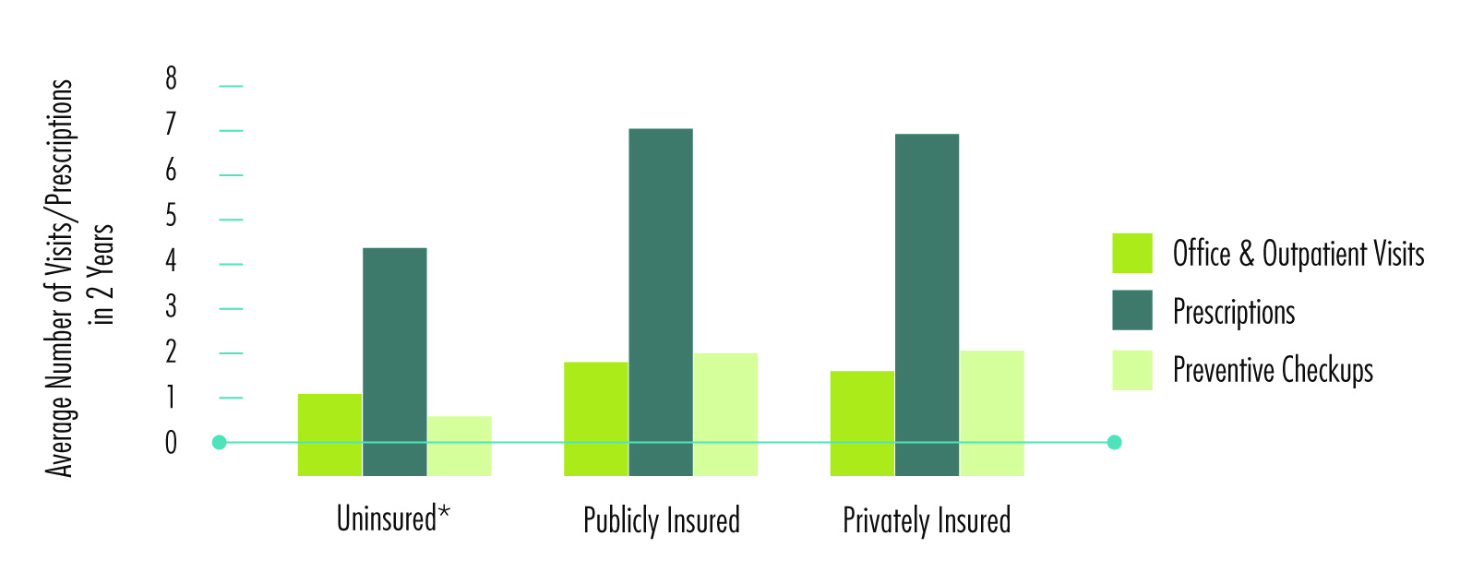
QUALITY: Factor #2
Suboptimal quality of clinical care, case management, asthma education for many children, including those ineligible for insurance coverage
Source: Kim et al. (2009). Health Care Utilization by Children with Asthma, Preventing Chronic Disease Vo. 6:No. 1

Slide 29
U.S. Hospital Admission Rates for Asthma, Ages 0-4, by State, 2002-2007
Rate per 100,000 population:
Source: CDC Asthma Control Program State Burden Reports, 2006-2010

Slide 30
U.S. Hospital Admissions for Asthma, Children and Adults, by Race/Ethnicity, 2002

Slide 31
Hospital Admission Rates for Asthma, All Children Ages 2-17, by Race/Ethnicity, 2001-2004
Rate per 100,000 population:
Consistently one of the largest disparities in QOC for Black compared to white children – 4x more likely
Source: AHRQ, HCUP SID disparities analysis file, 2001-2004.

Slide 32
Hospital Admission Rates for Asthma, Black Children Ages 2-17, by Median Income, 2001-2004
Rate per 100,000 Population:
Source: AHRQ, HCUP SID disparities analysis file, 2001-2004.

Slide 33
Use of Appropriate Medications for Asthma, Children Ages 5-17, 2008
Pennsylvania
Source: HHS, Annual Report on the Quality of Care for Children in Medicaid and CHIP, 2010; PA Department of Public Welfare, ACCESS Plus Data, 2009.

Slide 34
ENVIRONMENT: Factor #3
Failure to address the indoor air environment and other indoor asthma triggers as well as outdoor environmental triggers that affect communities in which children live and grow
Approximately 64% of children live in counties where the 8 hour ozone standard is violated at least 1 day annually
Over 60% live in communities where 1 or more federal air quality standards are not met

Slide 35
Surveillance DATA: Factor #4
Absence of systematic means for monitoring asthma prevalence and treatment effectiveness at the local level and for deploying targeted resources to most burdened communities
Prevalence of over 43% in West Brookfield in Massachusetts, compared to over 20% in 4 other communities and 5-15% in the remaining areas of the state

Slide 36
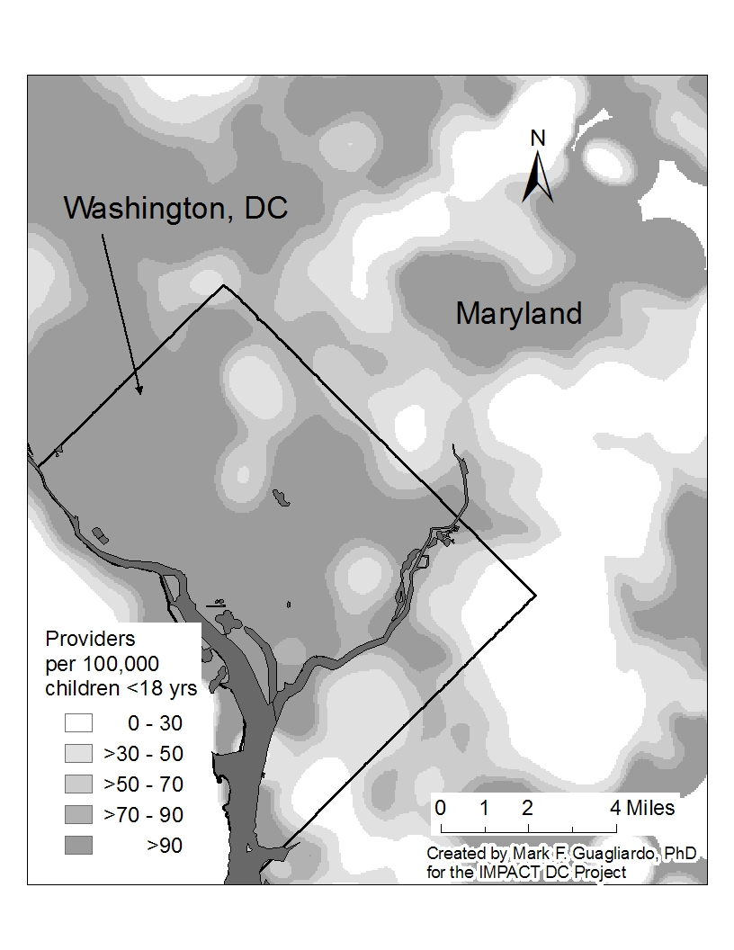
CNMC ED Visits for Children <Age 18 by Zip Code, 2006, and Primary Care Access in Washington, DC, 2005
Source: Teach, S. Improving Pediatric Asthma Care in the District of Columbia –IMPACT DC. September 13, 2010 Presentation to NAEPP Coordinating Committee Meeting. More information available at: www.impact-dc.org Children’s Research Institute, CNMC

Slide 37
Research DATA: Factor #5
Lack of a coordinated research strategy
NIH funding for asthma research decreased by 25% between 2005-2009 ($252 million in ’09)

Slide 38
Identified Priority Elements for Improvement
Asthma trigger reduction in homes and communities
High quality clinical and case management
Continuous information exchange and progress monitoring
Research to learn more about what works
Stable and continuous health insurance

Slide 39
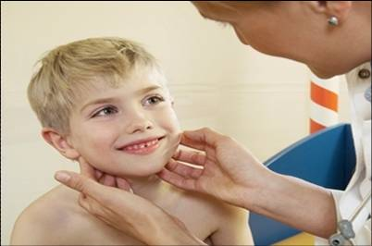
Improving Coverage: Specific Recommendations
Encourage all states to expand MA/CHIP up to at least 300% FPL
Increase and target outreach, enrollment and retention efforts in MA/CHIP
FQHC outstationing
Schools and other community–based locations
Encourage providers to make MA/CHIP enrollment a part of the individual asthma treatment plan for every child with asthma who is eligible for coverage
Stable and continuous health insurance

Slide 40
Sources of Coverage for Children in the Era of Health Reform
2010
If low income and eligibility categories
Medicaid (133% 0-5; 100% 6-18)
CHIP (>Medicaid levels, up to 300%+)
If can afford
Private (I, SG, LG)
Federal, state, CHAMPUS employees
PPACA
Starting in 2014
Medicaid for all <133% (138% AGI), including children
Medicaid/CHIP MoE
By 2014
I and SG in HIE with subsidies 133%-400%
CHIP option to cover state employees’ children

Slide 41
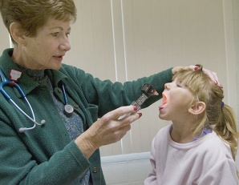
Improving Quality: Specific Recommendations
Develop an HHS-led, cross-agency, Administration-wide guidance on how to comprehensively address quality asthma care, including measurement and indicators
Make all recommended care a focus of quality performance improvement for MA/CHIP, health centers, and IHS
High quality clinical and case management

Slide 42

Improving Information Exchange & Progress Monitoring: Specific Recommendations
Continuous information exchange and progress monitoring
Enhance asthma monitoring at the community level through linkages of existing data sources (e.g., vital statistics, hospital discharge data, Medicaid claims), local and regional model registries, uniform datasets
Encourage meaningful use of HIT among providers and link providers to public health agencies to facilitate continuous information exchange and communication of up-to-date data

Slide 43
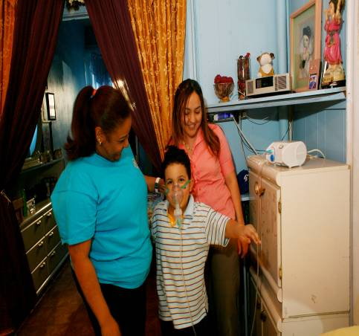
Improving Environmental, School and Housing Air Quality: Specific Recommendations
Asthma trigger reduction in homes and communities
Encourage public health agencies, education authorities, housing authorities, and environmental agencies to promote evidence-based interventions and services that fall outside of the traditional health care interventions to reduce exposure to asthma triggers

Slide 44
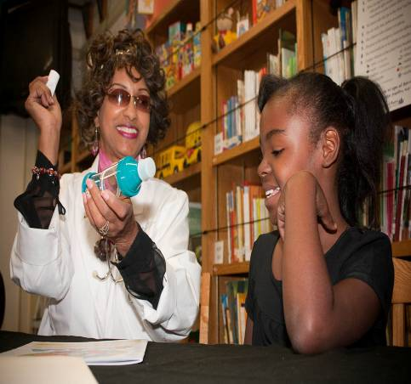
Improving Research Agendas: Specific Recommendations
Research to learn more about what works
Promote a strengthened and diversified Administration-wide research agenda to include basic, clinical, and translational/implementation investigations to learn more about what works and what can be translated into policy change

Slide 45
The Affordable Care Act, Medical Homes, and Childhood Asthma: Key Opportunity for Progress
August 2010
RESEARCH BY
SUPPORTED BY

Slide 46
ACA Furthers the Promise of Properly Managing Chronic Conditions like Childhood Asthma
COVERAGE & FINANCING
Medicaid and HIE coverage expansions will lower proportion of uninsured children and increase proportion of Medicaid and privately-insured children
Integrated eligibility system for Medicaid with HIE will make coverage more stable
Increased Medicaid reimbursement to Medicare levels for E/M services and PCPs, with federal matching rate limited in time will increase access to care
As prevention funds become available, opportunities for investments in community health interventions Medicaid does not fund but are essential to reducing the financial burden of asthma – such as abatement of home risks - will arise

Slide 47
ACA Furthers the Promise of Properly Managing Chronic Conditions like Childhood Asthma
DELIVERY SYSTEM
Pilot testing in Medicaid of pediatric Accountable Care Organizations (ACO), medical homes, bundled payment arrangements will provide opportunities to focus on high cost conditions like asthma
Medical home option for state Medicaid programs
Increased funding for CHCs will increase access to primary care in medically underserved communities

Slide 48
Medical Home Model
Origins with the AAP, now seen as a means to improve primary care for all patients
Goals:
Reduce duplication, excess cost, and inefficiencies in the delivery system
Promote access to more integrated health care
Features:
Comprehensiveness of care
Patient-centered care
Cultural appropriateness
Emphasis on care in the community
Use of cost-effective treatments
Use of electronic health information to improve clinical quality, report on health outcomes, and better manage patient health
Particularly beneficial for medically complex patients, including CSHCN who need multiple health care services and case management

Slide 49
ACA Provisions on Medical Homes
Statutory definition of medical home
HHS to develop a quality measure capturing use of medical homes for individual and group health plans
CMI to test innovative payment and service delivery models to reduce expenditures and enhance quality, including a patient-centered medical home model
State Medicaid agencies may choose to permit individuals with one or more chronic conditions-asthma specifically listed-to select a health home (e.g., CHC, health team) responsible for:
Comprehensive care management; care coordination and health promotion; comprehensive transitional care, including appropriate follow-up from inpatient to other settings; patient and family support; referral to community and social support services; and use of HIT to link services as feasible and appropriate

Slide 50
Recommendations for Implementation of Medical Homes for Children with Asthma
Development of all-payer performance measures in pediatric asthma
Incorporation of the measures on pediatric asthma into health home/medical home performance assessment (e.g., health centers)
Updated guidance by CMS to Medicaid and CHIP programs on improving the quality of care for children with asthma
Measures to assess the meaningful use of EHRs by providers to include additional measures on pediatric care, including asthma care
Childhood asthma as a national public health priority for prevention activities and evidence-based interventions that are features of medical homes (e.g., CHWs and asthma-related environmental education and intervention in the home) since they become a means of bridging direct health care services and public health

Slide 51
What Would an Ideal System of Care for Children with Asthma Look Like?
Community
Hospital & ED Care
Specialty Care
Diagnostic Services
PCPs & CHCs Primary Health Care Homes
Child’sHome
School Health
Environmental & Housing
Prevention & Public Health
Community

Slide 52
Collaboration & Coordination are Key in More Effectively Addressing the Burden of Asthma
Primary Care
Specialty Care
Acute Care
CHILDHOOD
ASTHMA
PREVENTION
DIAGNOSIS & TREATMENT
MANAGEMENT
Private Insurers
Education
Public Payers
School Health Services
Environment
Housing
Public Health Surveillance
Public Health Programs
Public Health Research

Slide 53
MORE INFORMATION?
Changing pO₂licy: The Elements for Improving Childhood Asthma Outcomes
The Affordable Care Act, Medical Homes and Childhood Asthma: A Key Opportunity for Progress
RESEARCH BY
SUPPORTED BY

